Slide 1
Dictionary of Classic Mayan
Participants Symposium. 8. December 2017, Lexical Data Master Class, Berlin
A First Entry for kakaw
Franziska Diehr
Niedersächsische Staats- und Universitätsbibliothek, Göttingen
diehr@sub.uni-goettingen.de

Slide 2
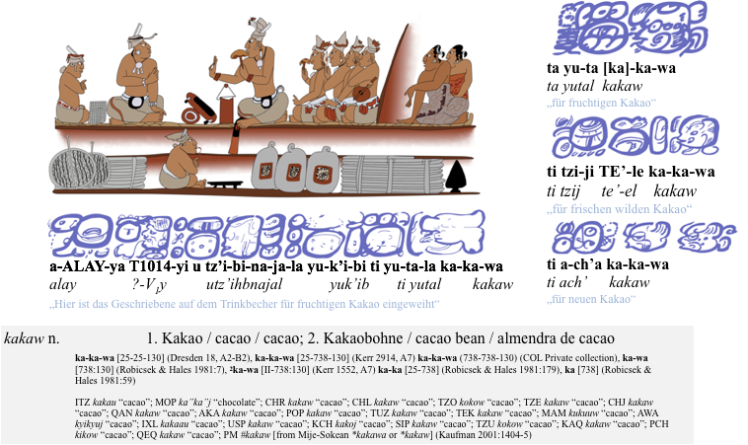
kakaw Entry Example

Slide 3
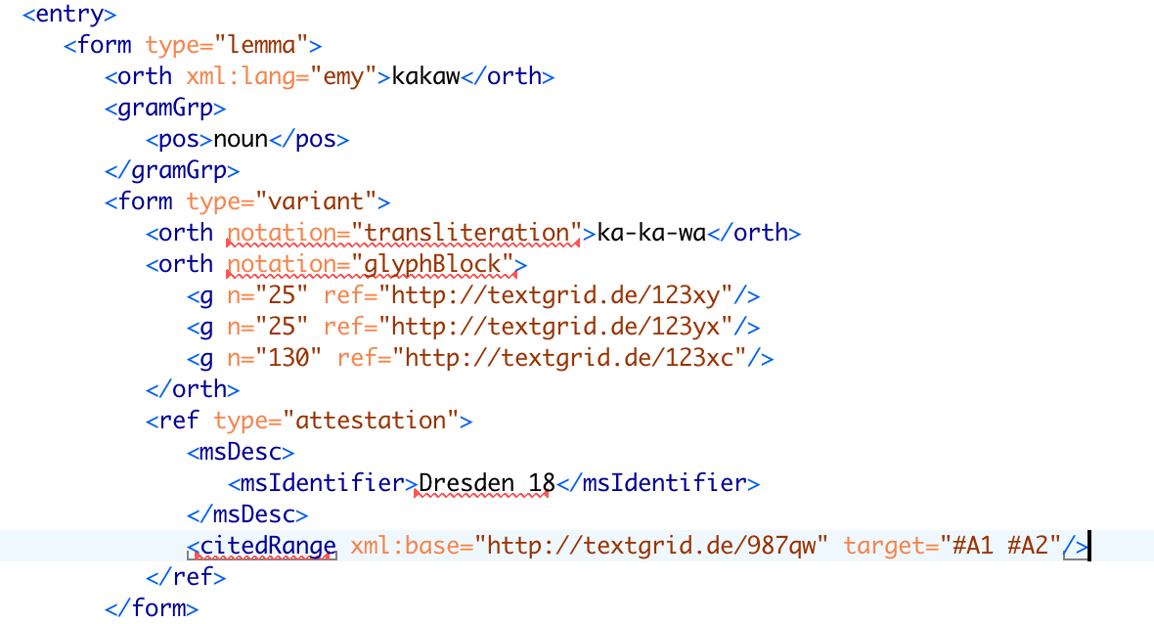
Lemma and Variants & how to point to the corpus/original writing

Slide 4
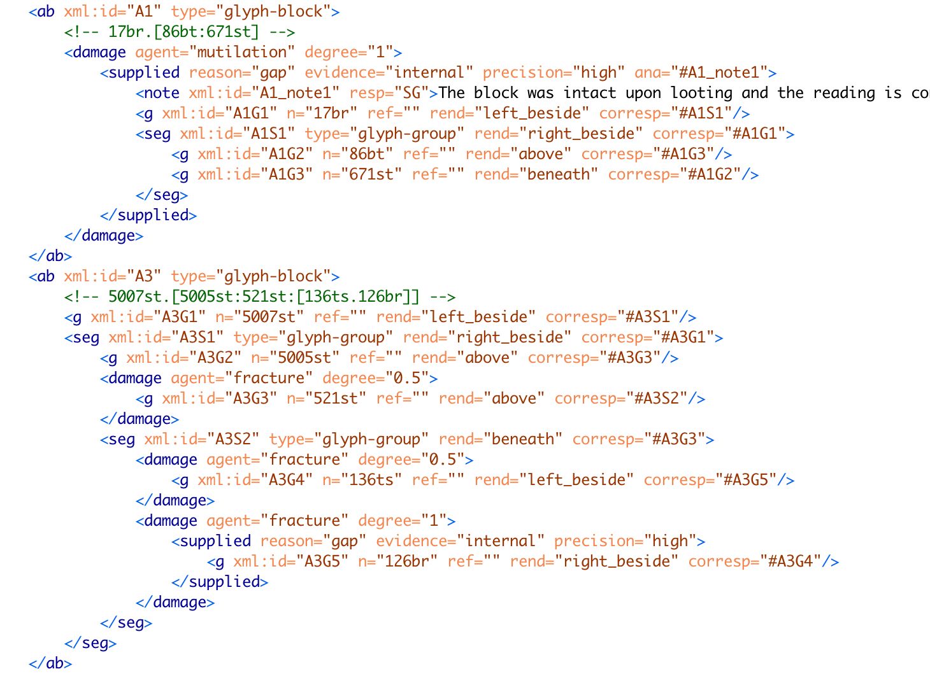
the hieroglyphic block in the corpus (example)

Slide 5
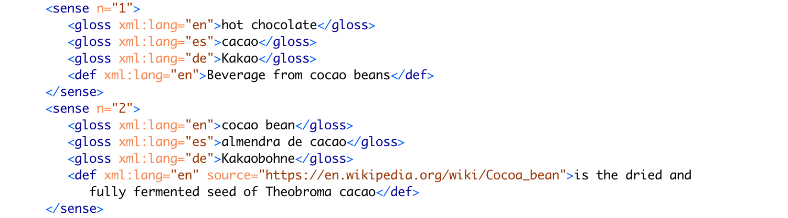
senses and translations of kakaw

Slide 6
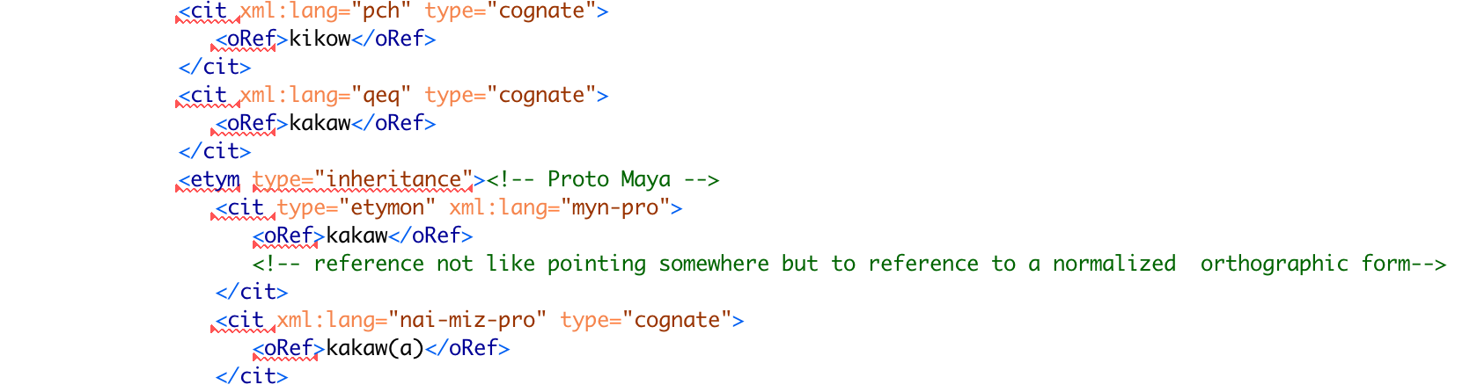
Etymology

Slide 7
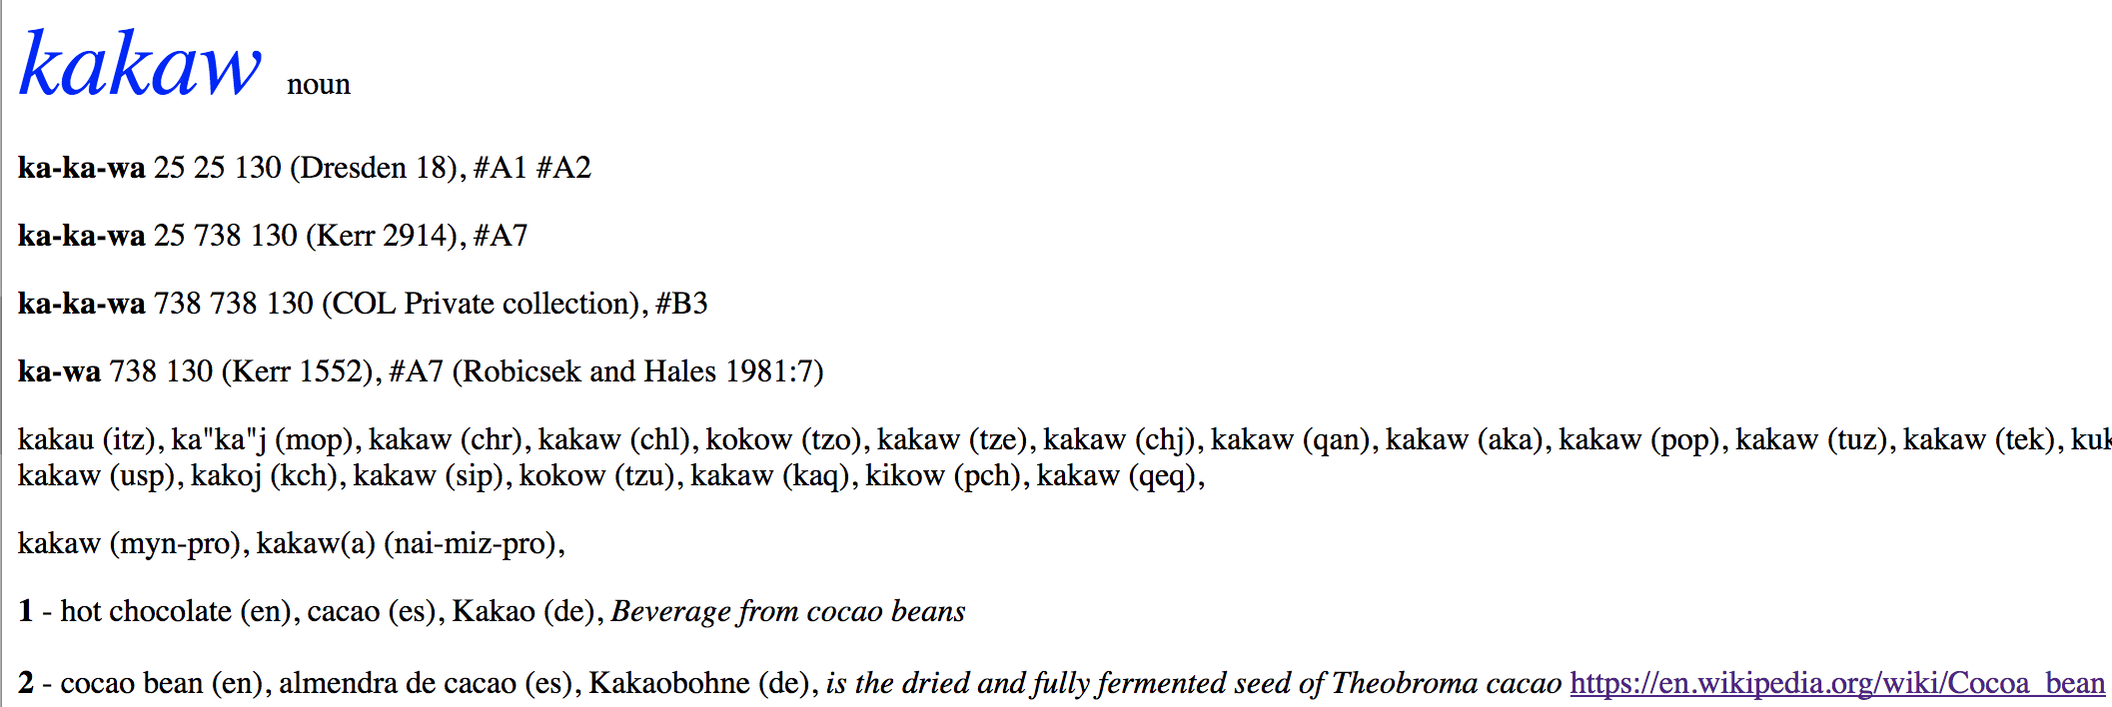
the kakaw entry in HTML
compared to: kakaw example entry

Slide 8
25 25 130
= Catalogue Number of Glyph
(Dresden 18)
= Codex = Original Document
#A1 #A2
= xml:id of <ab type=”glyph-block” as encoded in the corpus
← Cognates in modern Mayan languages
← inheritance from Proto-Mayan
and cognate in sister language

Slide 9
Future Work
check with colleagues if I got the etymology right
bringing together data from our linguistic analysis and corpus and convert this into the TEI dictionary file
TEI file as sustainable version of the dictionary
data basis for the creation of the printed version of the dictionary

Slide 10


Further Information and Contact
http://mayawoerterbuch.de/ Projekt Website
@idiom_project Twitter
@idiom.project Facebook
Präsentation (CC-BY-4.0)
Franziska Diehr
Gruppe Metadaten und Datenkonversion
SUB Göttingen
Platz der Göttinger Sieben 1
37073 Göttingen
+49 551 39- 14070
diehr@sub.uni-goettingen.de
@FranziDiehr

